Slide 1

Software Testing and Quality Assurance
Nawarathne D.H.G.J.V.
EG/2022/5208

Slide 2
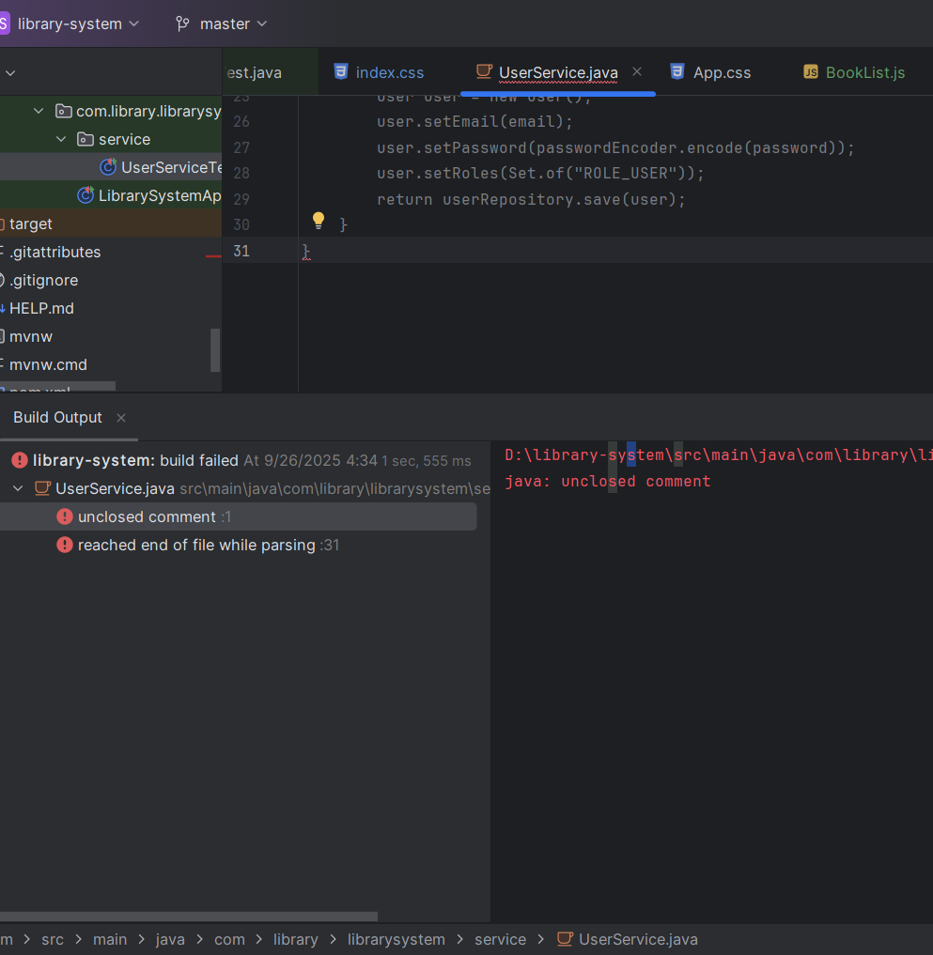
TDD Approach(Red-Green-Refactor cycle)
User Registration Validation
Book Creation Ownership
1. RED - Write a Failing Test

Slide 3
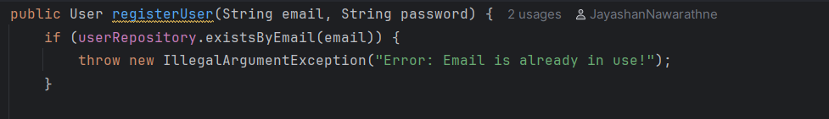
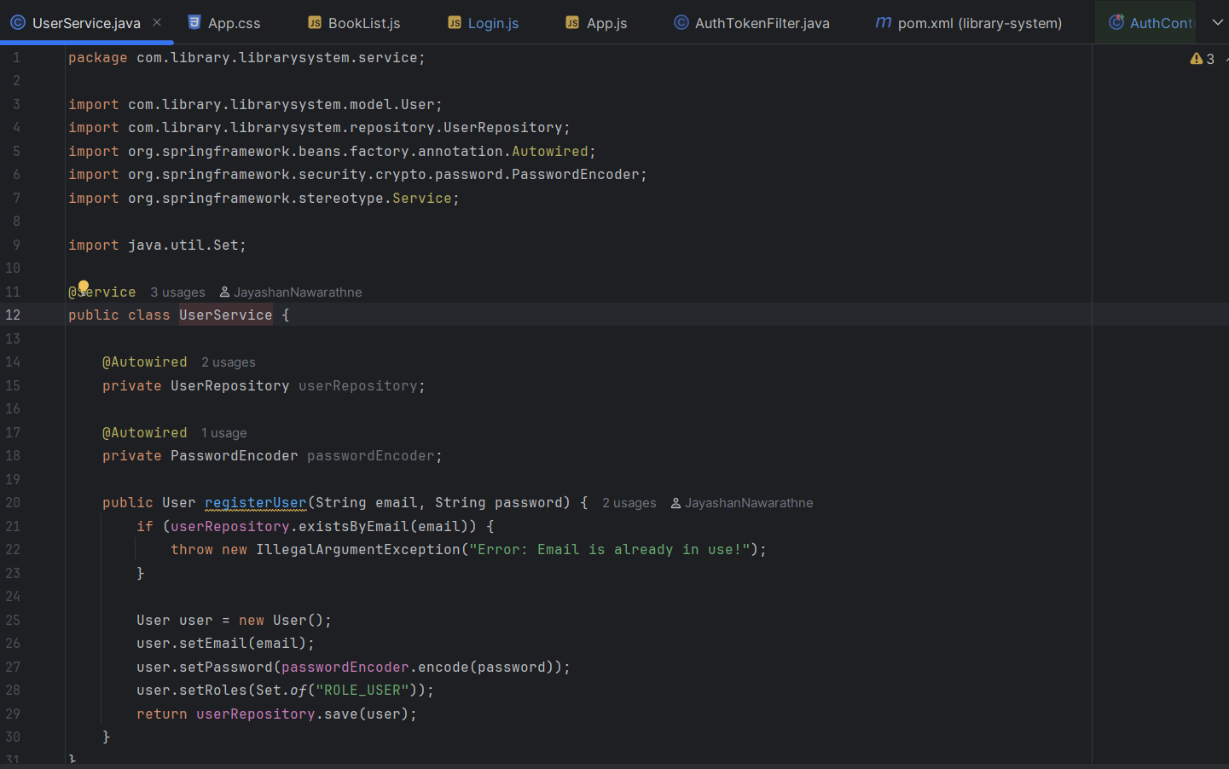
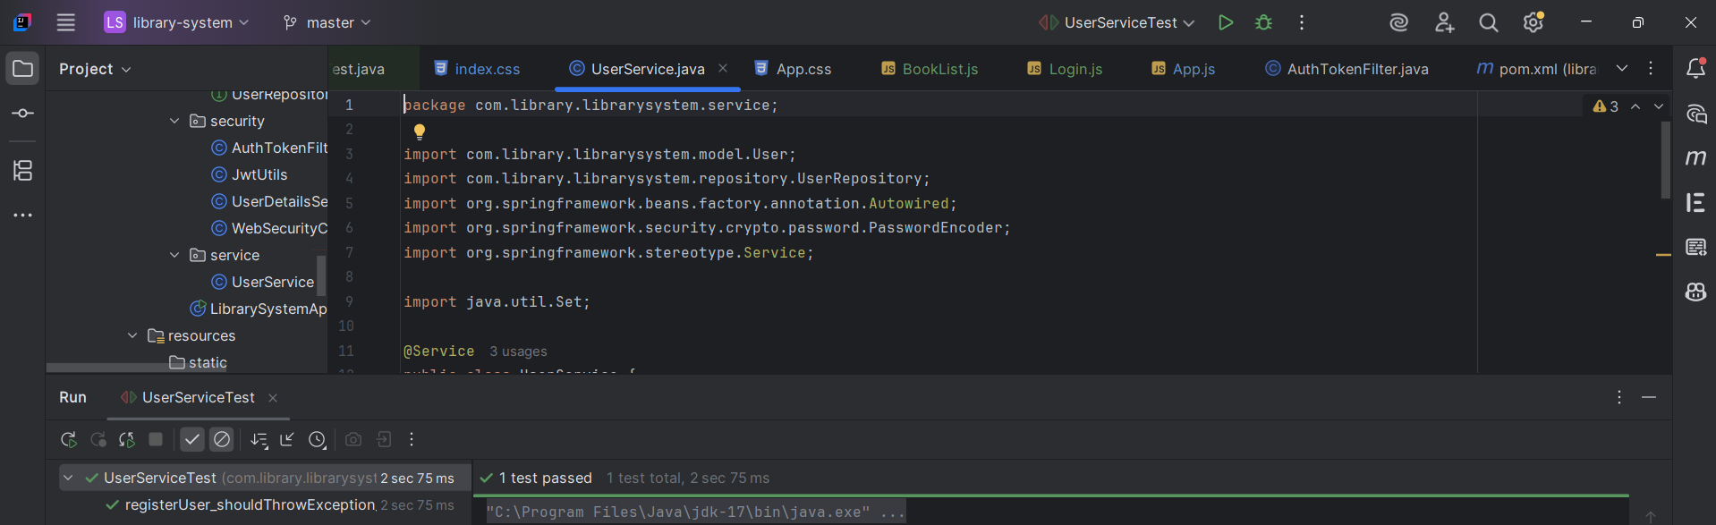
2. GREEN /REFACTOR Write Code to Pass the Test

Slide 4
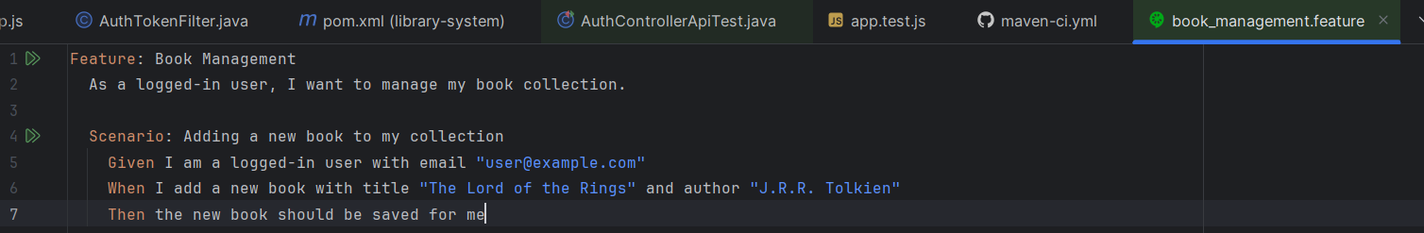
Behavior-Driven Development (BDD)
Cucumber for this

Slide 5
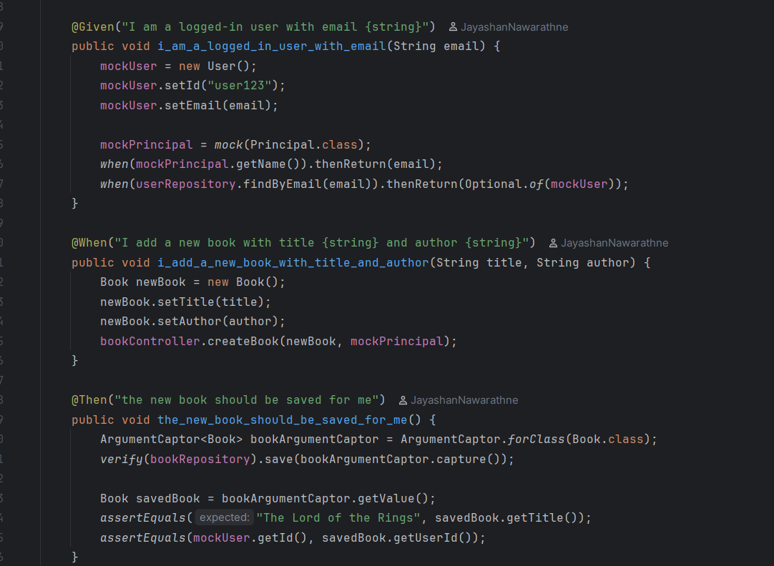
step definition

Slide 6
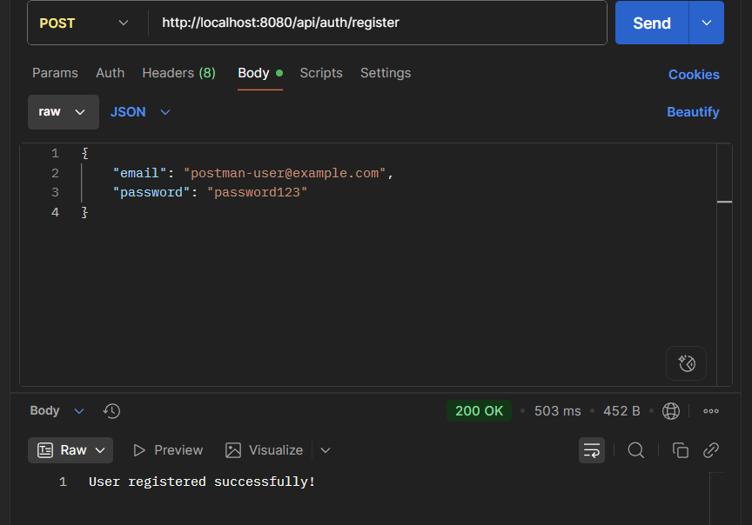
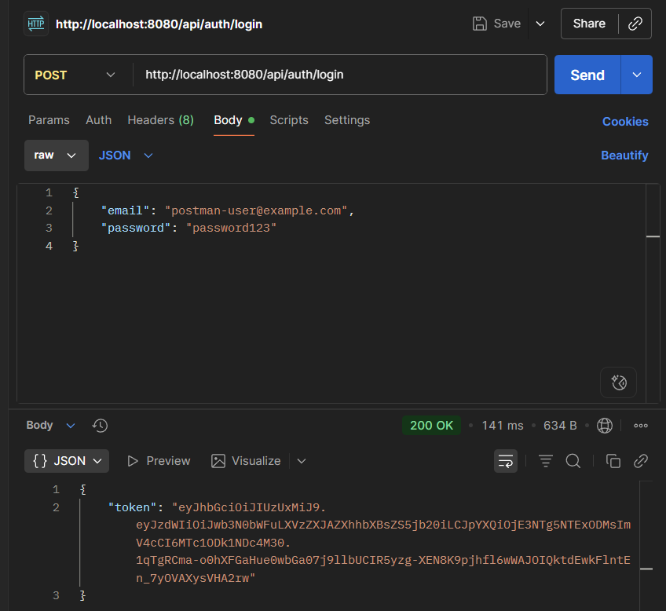
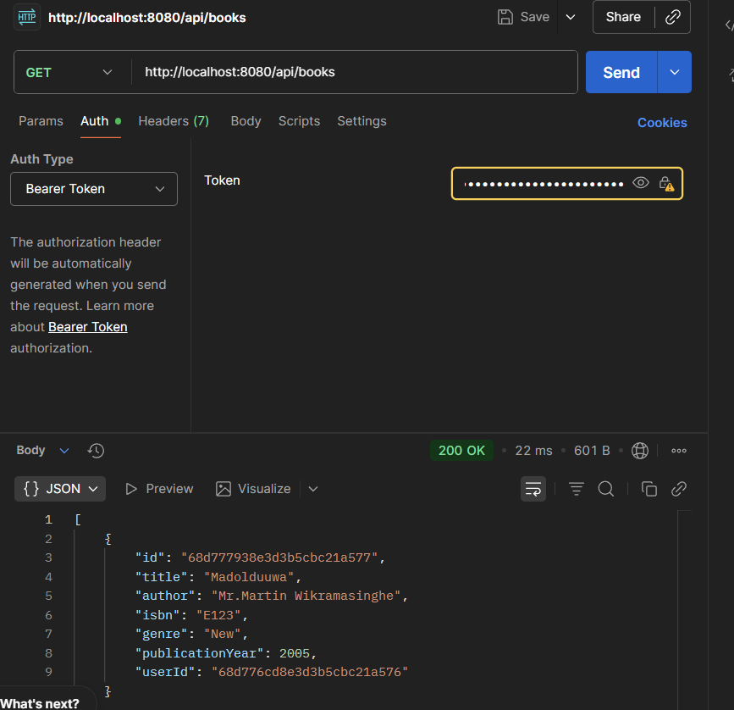
Test Automation & Continuous Integration
Test Automation
API Testing with REST Assured and Postman

Slide 7
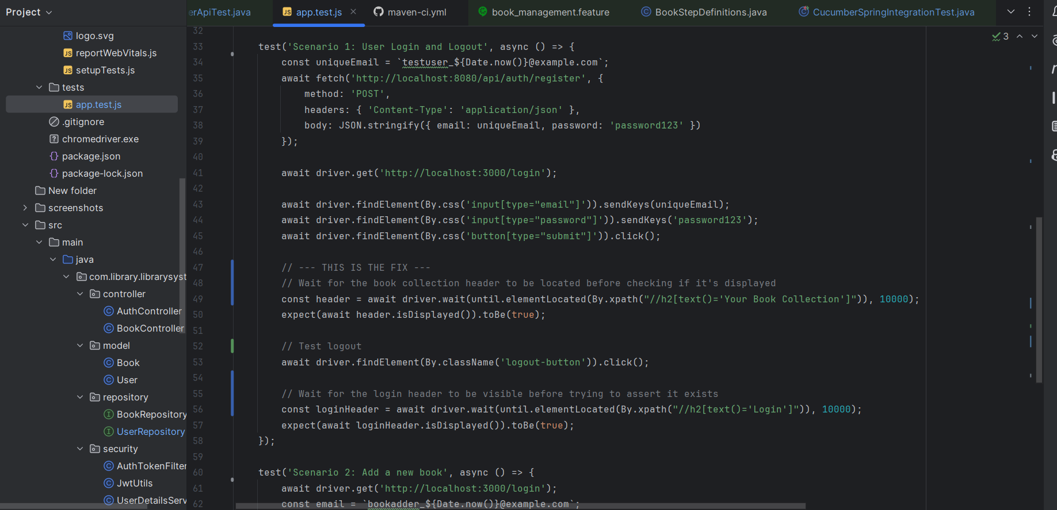
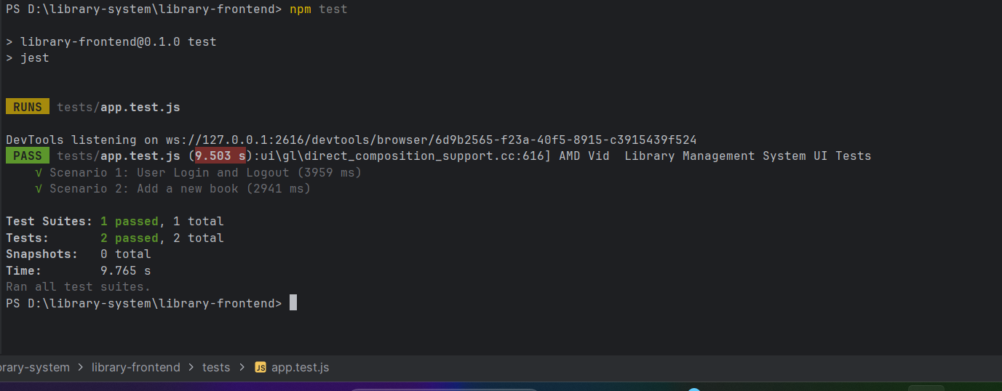
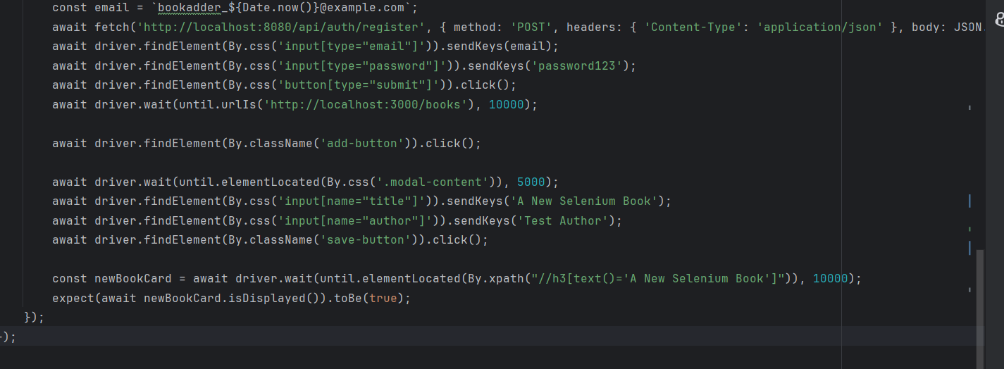
UI Testing with Selenium & Jest (Frontend)

Slide 8
Automated Unit Tests
1. Test 1: The UserServiceTest.java
created during the TDD section
2. Test 2: The BookStepDefinitions.java
created for BDD also acts as a unit test for the controller logic

Slide 9
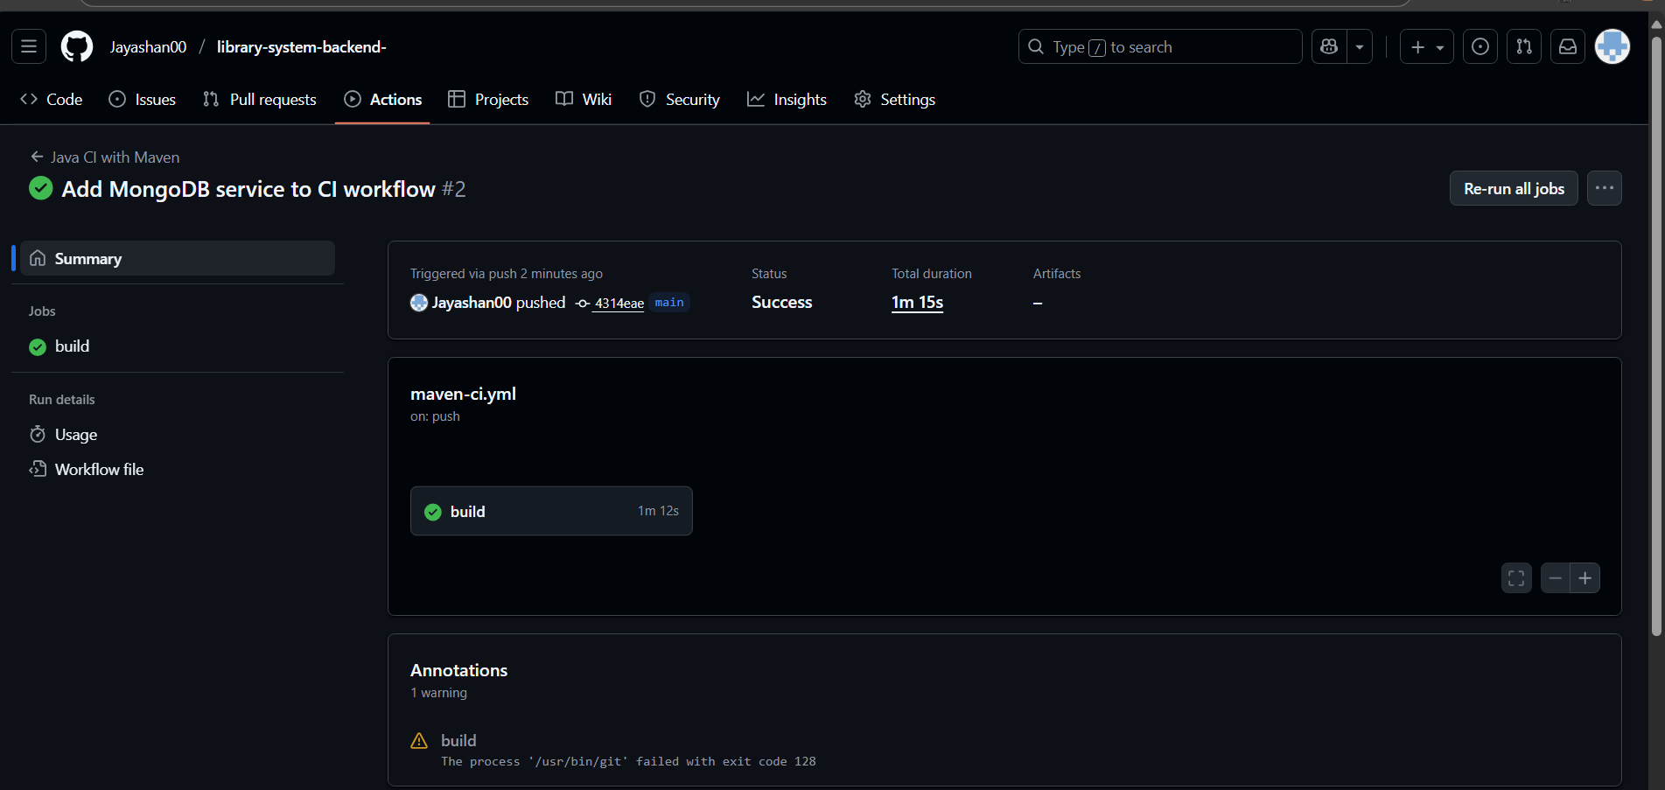
CI/CD pipeline

Slide 10
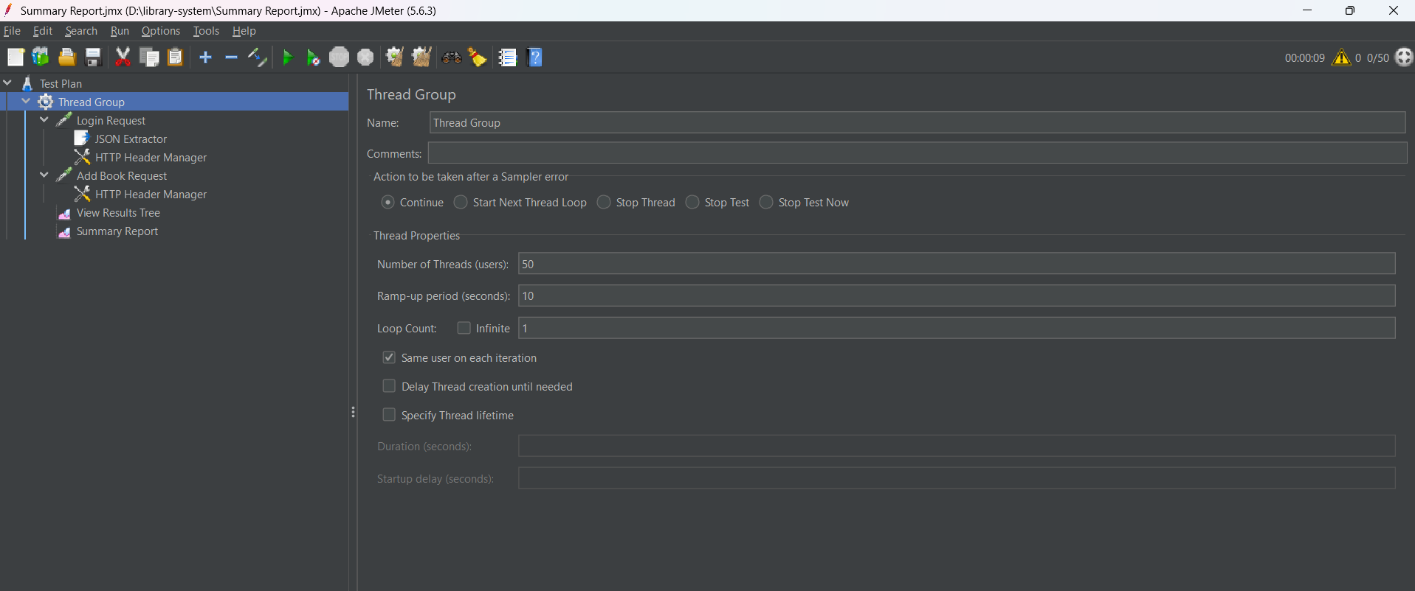
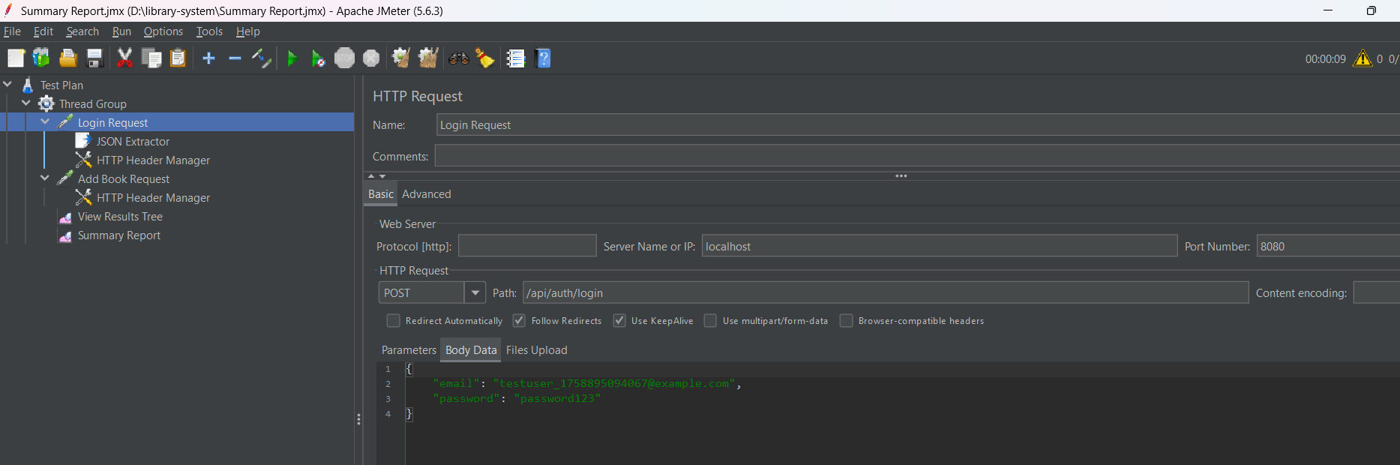
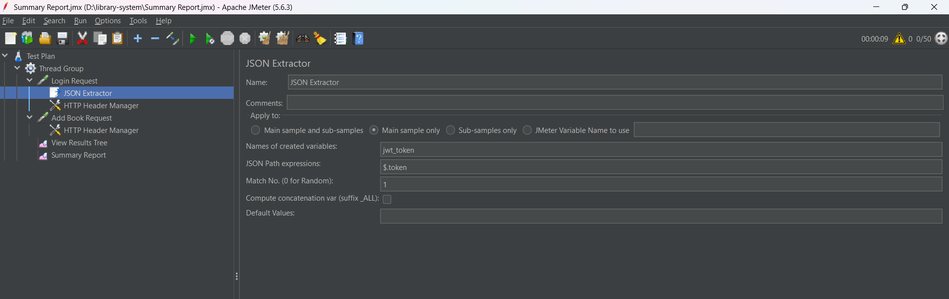
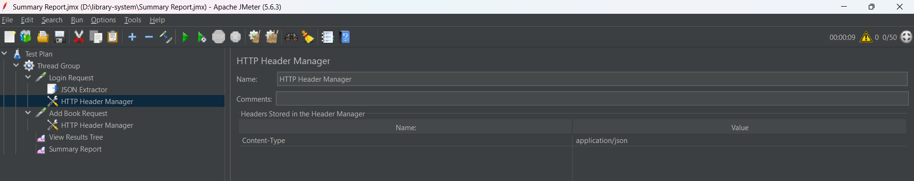
Performance, Security, and Usability Testing

Slide 11
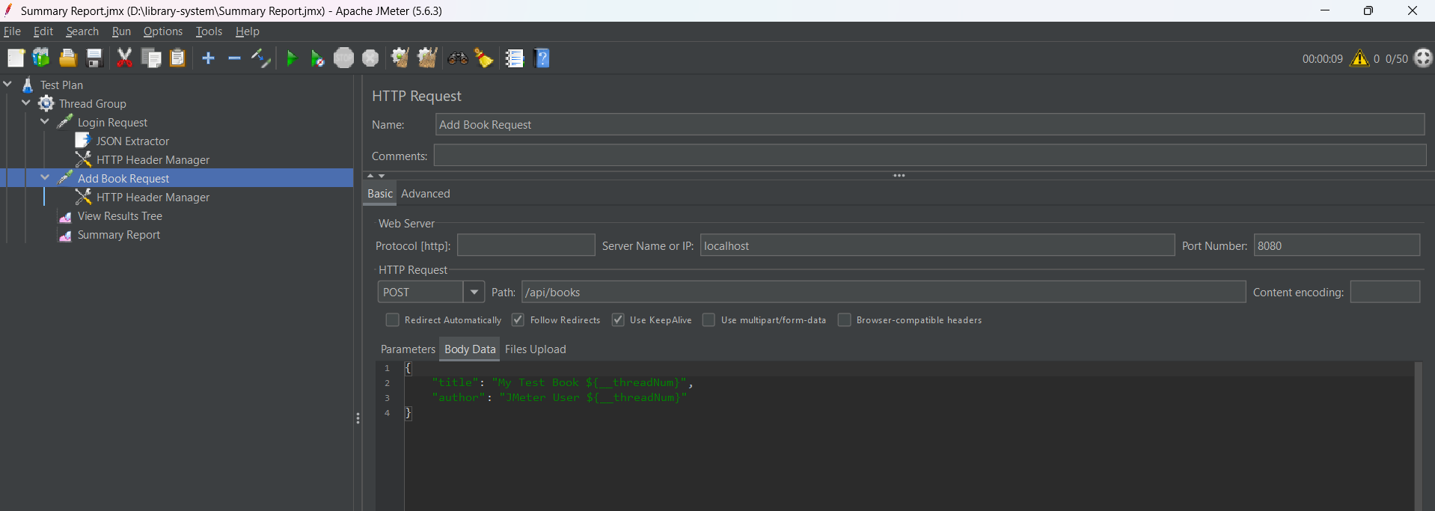
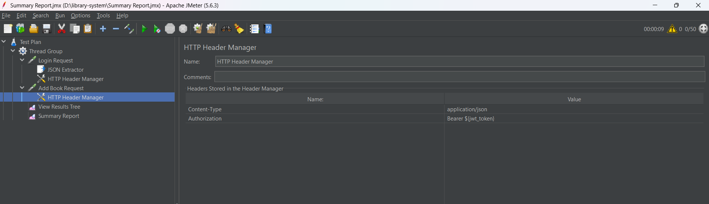
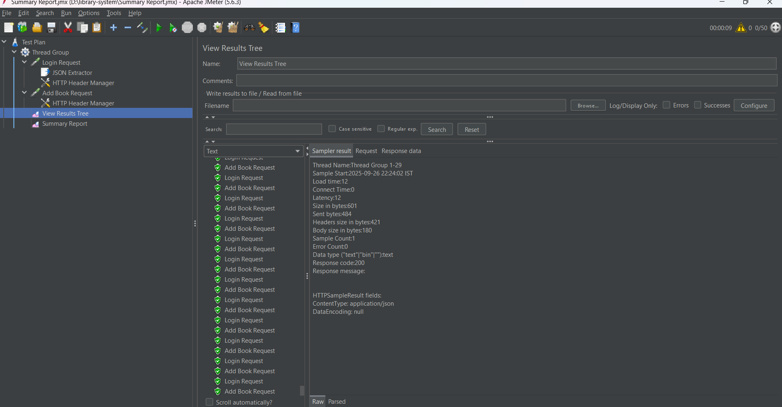
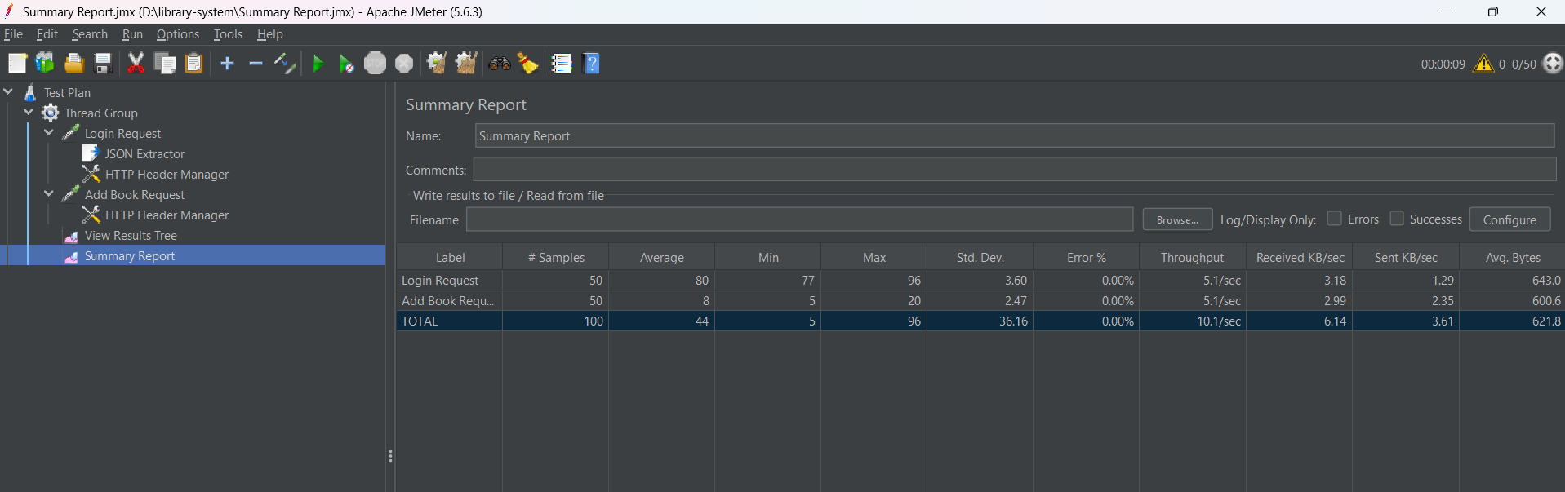

Slide 12
Analyze Results
Critical API Endpoint:choose POST /api/books (adding a new book). It's a perfect candidate because it's a common action that requires both authentication and a database write operation
Throughput: Number of requests server can handle per second. (10.1/min) -better
Average / Median: The average time (in milliseconds) a request took. (44ms) -better.
Error %: The percentage of requests that failed. (0%.)

Slide 13
Security Testing
Vulnerability #1: A03:2021 – Injection
Injection happens when an attacker can send malicious data that is executed by your application. Since I’m using Spring Data MongoDB, we are already protected from NoSQL injection
Vulnerability #2: A01:2021 - Broken Access Control
This happens when a user can access or modify data they shouldn't be able to. We already fixed this by checking the userId in our BookController

Slide 14
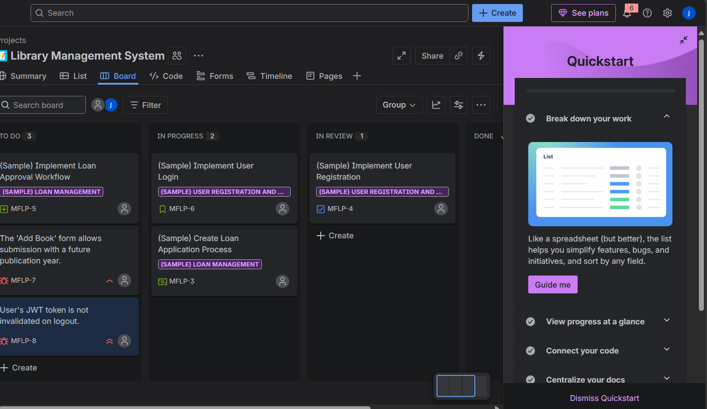
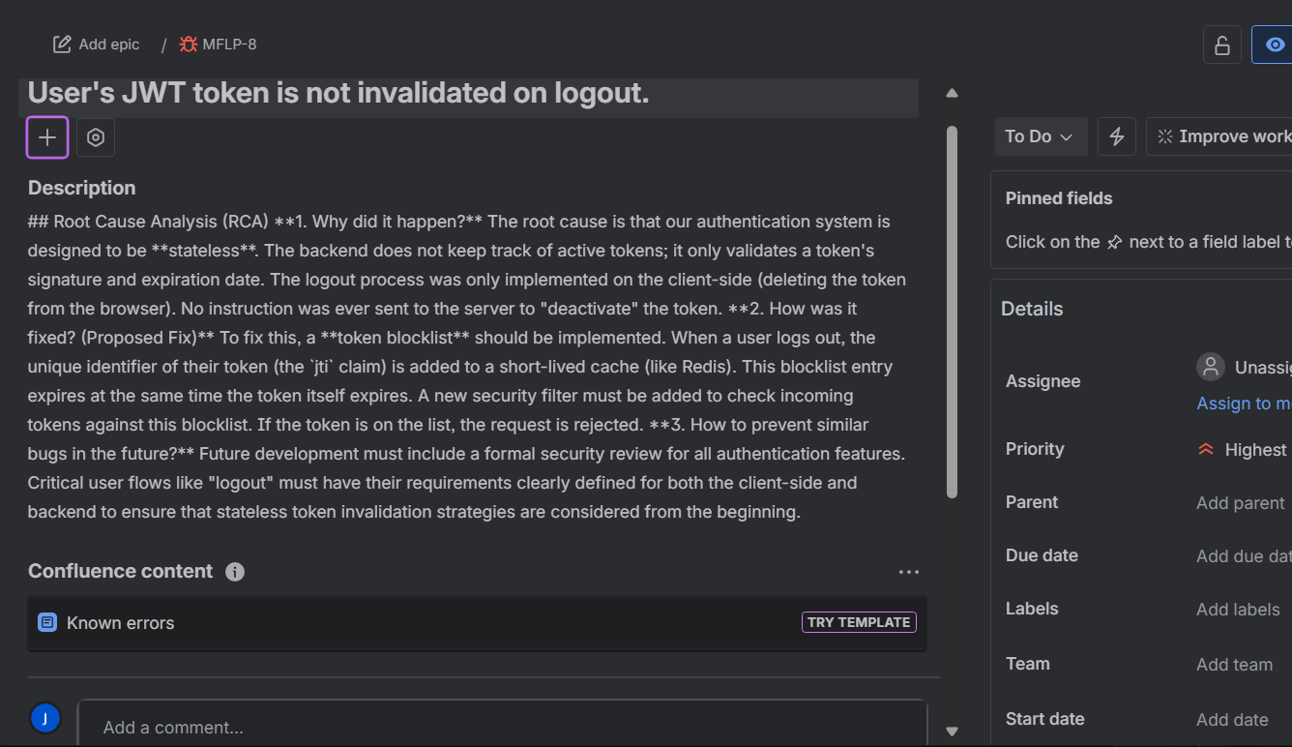
Defect Tracking

Slide 15
Defect Density
Defect Density = (Number of Defects / Lines of Code) * 1000 (bugs per "Kilo-LOC" or 1000 lines of code)
For BookController.java,
Defect Density = (Number of Defects / Lines of Code) * 1000
lines of code =79
Number of Defects = 1
Defect Density = (1 Defect/ 79 Loc)*1000
=12.6
A lower number is better

Slide 16
Mean Time to Failure (MTTF)
MTTF is the average time a system operates correctly before a failure occurs
Cycle 1: The application ran for 10 hours before a critical security bug caused a failure.
Cycle 2: After a fix, the application ran for 15 hours before a database connection issue caused a second failure.
Cycle 3: After the next fix, the application ran for 20 hours without any failures before the testing cycle ended.
Calculation:
MTTF =(Total operational time before failures) / (Number of failures) MTTF = (10 hours + 15 hours) / 2 failures
MTTF = 12.5 hours

Slide 17
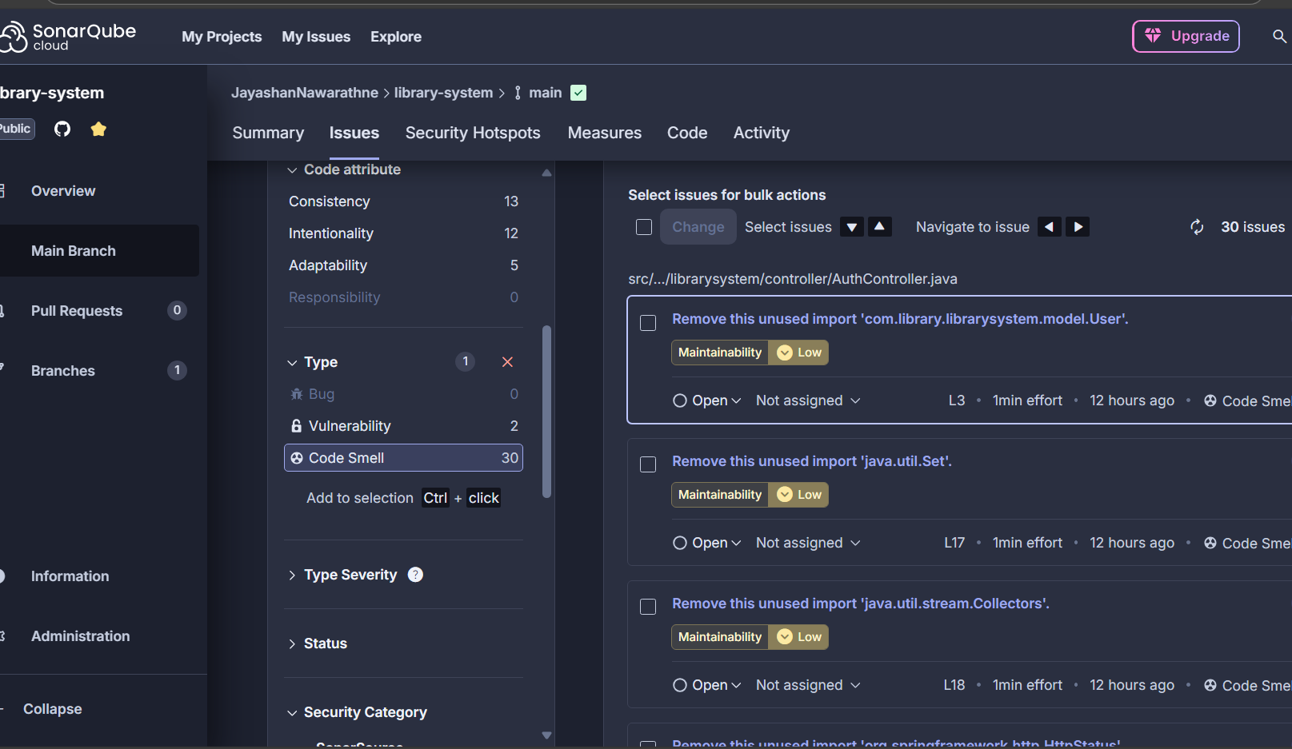
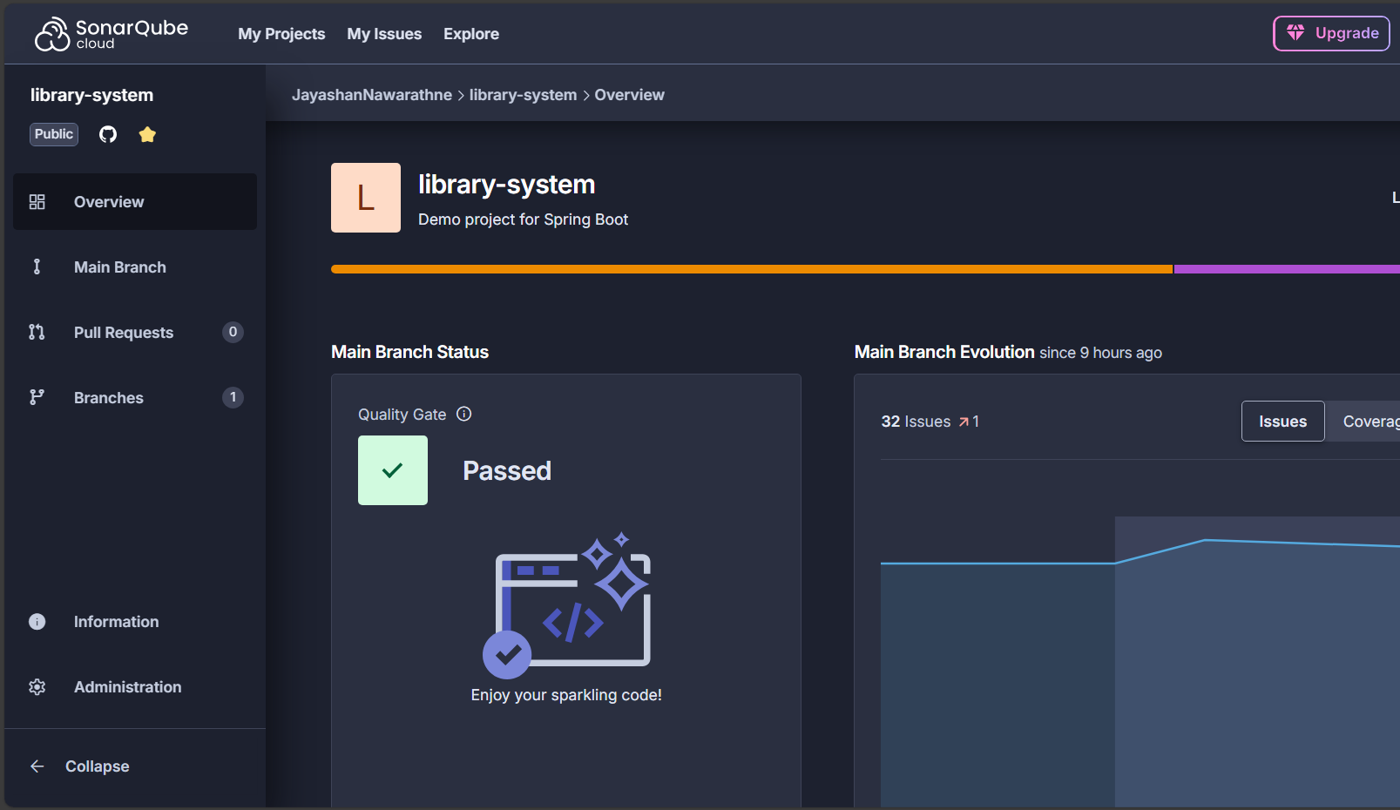
SonarQube Analysis (using SonarCloud)

Slide 18
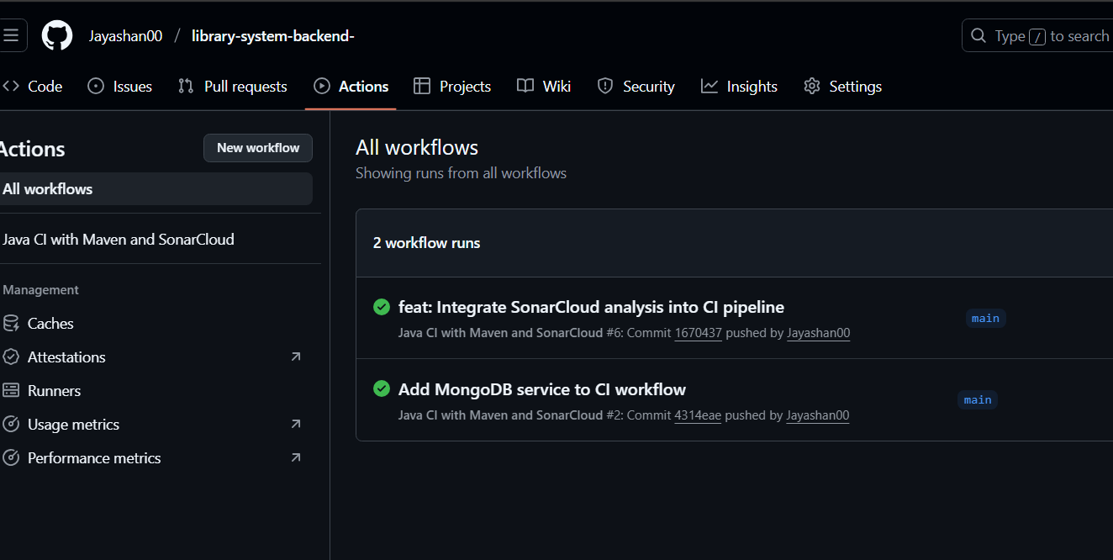

Slide 19
Thank You!

